Slide 1


DEMOCRATIC AND PEOPLE’S REPUBLIC OF ALGERIA
MINISTRY OF HIGHER EDUCATION AND SCIENTIFIC RESEARCH
HOUARI BOUMEDIENE UNIVERSITY OF SCIENCE AND TECHNOLOGY
DEPARTMENT OF COMPUTER SCIENCE
000
Report on:
Information and Communication Technologies
(TIC)
Students Names:
Ferhat Omar.
Academic Year: 2025/2026

Slide 2
Plan
000
1. Introduction
2. Definition of TIC
3. Importance of TIC
4. Technologies Related to TIC
5. TIC in Education and Work
6. Advantages and Challenges of TIC
7. Conclusion

Slide 3
1. Introduction
000
Information and Communication Technologies (ICT) are technologies used to manage information and facilitate communication.
Their rapid development has transformed learning, work, and interaction, playing a key role in sectors such as education, healthcare, business, and daily life by improving access to information, communication efficiency, collaboration, and digital services.

Slide 4
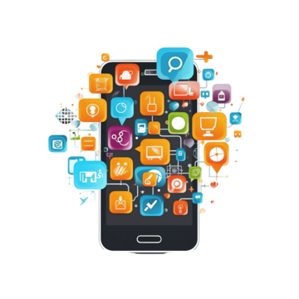

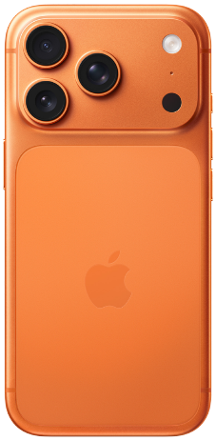


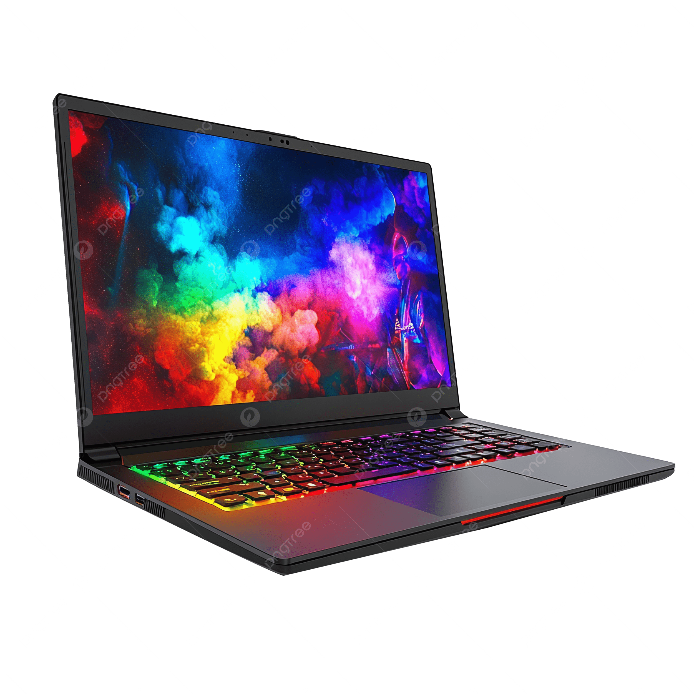


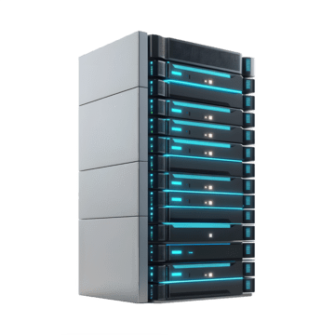

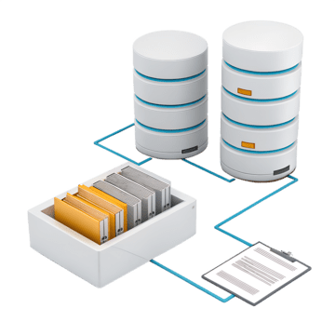
2. Definition of TIC
000
TIC includes:
Hardware: computers, smartphones, servers, networks
Software: operating systems, applications, cloud platforms
Communication technologies: internet, email, video conferencing, social networks
Information systems: databases, management systems
The main objective of TIC is to collect, store, process, transmit, and share information efficiently.

Slide 5
3. Importance of TIC
000
TIC is essential because it:
Improves communication and collaboration
Increases productivity and efficiency
Supports distance learning and e-learning
Facilitates digital transformation of organizations
Enables innovation and access to global information

Slide 6
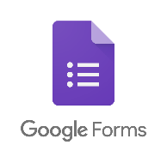





4. Technologies Related to TIC
000
4.1 Google Services
Gmail
Google Drive
Google Docs
Google Meet
Google Forms
Google Classroom
Advantages:
Free or low-cost
Real-time collaboration
Accessible from anywhere with internet

Slide 7






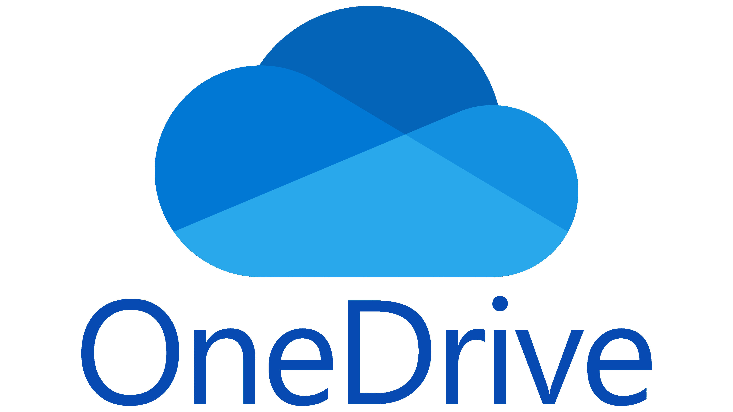
4. Technologies Related to TIC
000
4.2 Microsoft Tools
Microsoft Word
Microsoft Excel
Microsoft PowerPoint
Microsoft Outlook
Microsoft Teams
OneDrive
Windows OS
Document creation
data analysis and spreadsheets
Presentati-ons
Email and calendar
collaboration and online meetings
Cloud storage
Operating system
Advantages:
Professional standard
Advanced features
Widely used in companies and institutions

Slide 8


4. Technologies Related to TIC
000
Git
4.3 Git and GitHub
GitHub
A version control system
Allows tracking changes in files (especially code)
Enables multiple developers to work on the same project
Key features:
Version history
Branching and merging
Backup of work
A web platform that hosts Git repositories
Used for collaboration and project sharing
Main uses:
Store and manage code
Team collaboration
Open-source projects
Project documentation
Benefits:
Improves teamwork
Prevents data loss
Enhances software development workflow

Slide 9
000
5. TIC in Education and Work
Online courses and virtual classrooms
Remote work and teleconferencing
Digital documentation and data management
Research and information access
TIC reduces time, cost, and physical constraints.

Slide 10
6. Advantages and Challenges of TIC
000
Advantages | Challenges
Fast communication Global connectivity Easy access to information Automation of tasks | Cybersecurity risks Data privacy issues Digital divide (unequal access) Dependence on technology

Slide 11
7. Conclusion
000
Information and Communication Technologies are fundamental in modern society. Tools such as Google services, Microsoft applications, and Git/GitHub have transformed how people learn, work, and collaborate. Mastering TIC is essential for academic success and professional development in the digital age.

Slide 12
Thank you for your attention

